Slide 1
Domain Driven Design – part 2
Safal Mukhia

Slide 2
The Domain
“You cannot create a banking software system unless you have a good understanding of what banking is all about, one must understand the domain of banking. Is it possible to create complex banking software without good domain knowledge? No way. Never. Who knows banking? The software architect? No. He just uses the bank to keep his money safe and available when he needs them. The software analyst? Not really. He knows to analyse a given topic, when he is given all the necessary ingredients. The developer? Forget it. Who then? The bankers, of course.” – Abel Abraham and Floyd Marinescu.¹
¹Domain-Driven Design Quickly, InfoQ Enterprise Software Development Series: https://ress.infoq.com/minibooks/domain-driven-design-quickly/en/pdf/
Notes:
- Software solve a particular problem – they can be used to facilitate in completing a task. Lots of software are used for a particular purpose, in a particular sector or industry. Domain knowledge is required to make useful software in these cases. The software has to model the domain.

Slide 3
The Ubiquitous Language
- Modelling the domain is important to arrive at a design.
- Developers and domain experts will not speak the same language (most of the time).
- Common-language: derived from the model.
Notes:
Ubiquitous languages minimise ambiguity and inconsistency.
Forms of communication is kept relevant by focusing on the model.

Slide 4
Creating the Ubiquitous Language
- Code for any important concepts in the model.
- Document the language: diagrams that contain relations among a subset of the classes in the model.

Slide 5
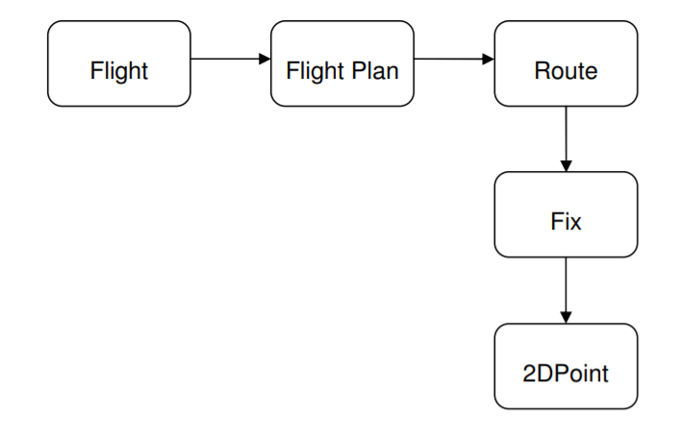
Example of how a Ubiquitous language is created.
Figure. An example model of Air traffic control system.
Notes:
- An example of why it is important to use ubiquitous language.

Slide 6
Thank you!

